Slide 1
MIKE 11
Simulation Editor

Slide 2
SIMULATION EDITOR
MIKE 11 Graphical User Interface (GUI)
The MIKE 11 graphical user interface is based on five ‘Editor’ interfaces
The main control editor is the ‘Simulation Editor’.
The simulation editor is the main control hub of a MIKE 11 simulation
Always leave the simulation editor open

Slide 3
SIMULATION EDITOR
Access All Files Through the Simulation File
The Editors are synchronised together using the ‘Simulation Editor’
Synchronising the editors together enables links to be developed from one editor to another
Network Editor (.nwk11)
Cross Section Editor (.xns11)
Simulation Editor (.sim11)
Boundary Editor (.bnd11)
Parameter Editor (.HD11)
Time Series Editor (.dfs0)

Slide 4
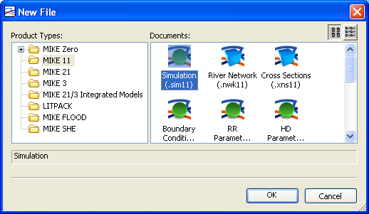
SIMULATION EDITOR
*.SIM11 File Extension
How? MIKE Zero -> File -> New -> File -> MIKE 11 -> Simulation (.sim11)
The simulation file contains all project information and provides dynamic links to all editors.
Always Create the
Simulation File First

Slide 5
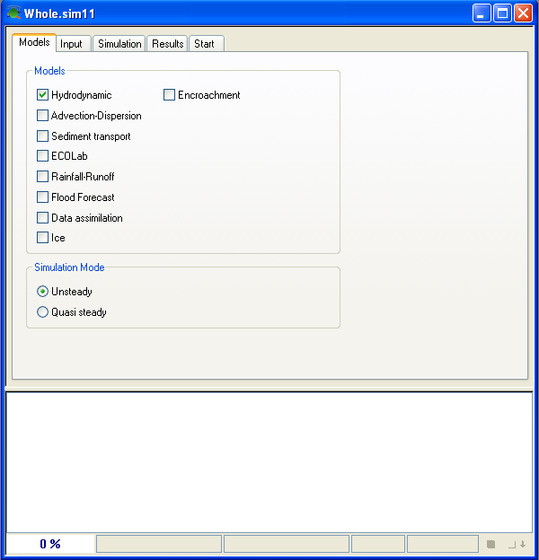
SIMULATION EDITOR
Models Tab
The Model Tab specifies the type of model to be used and the simulation mode

Slide 6
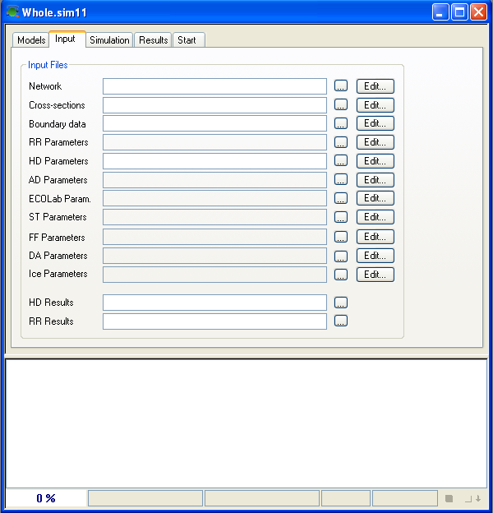
SIMULATION EDITOR
Input Tab
The Input Tab allows file specification based on model selections in the Model Tab
Browse for Files
Open Other Editors

Slide 7
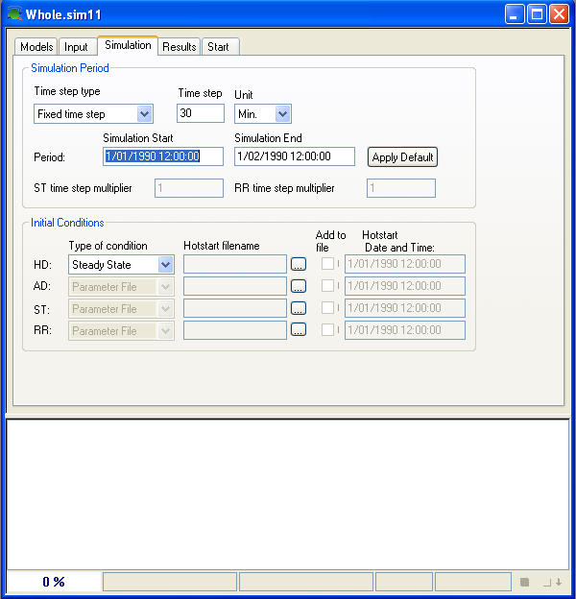
SIMULATION EDITOR
Simulation Tab
Select Time Step Type and Units
(Fixed, Tabulated or Adaptative)
The Simulation Tab contains initial conditions, computational time step and simulation details
Select Type of Initial Conditions
(Steady State, Parameter File or Hotstart)
Calculates the Maximum Simulation
Period Based on Given Inputs

Slide 8
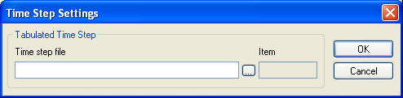
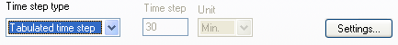
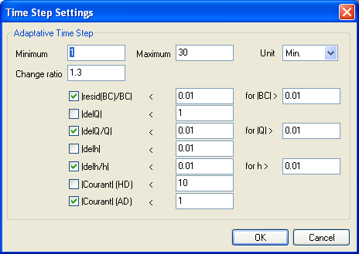

SIMULATION EDITOR
Time Step Settings
Uses Time Series (DFS0) File
Tabulated Time Step
Adaptative Time Step

Slide 9
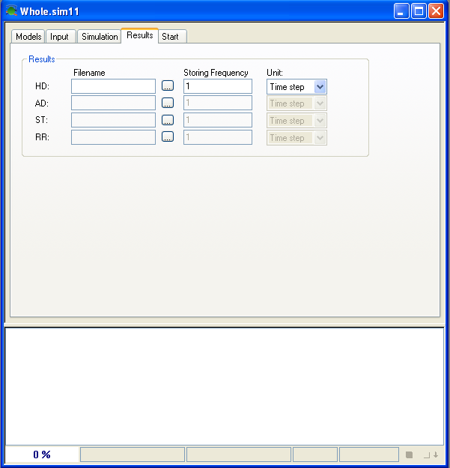
SIMULATION EDITOR
Results Tab
The Results Tab contains information on Results File names and saving frequency
Specify Name or
Browse for File
Store Results as a Multiple of Time
Step or a Specific Time Interval
(Seconds, Minutes, Hours or Days)

Slide 10
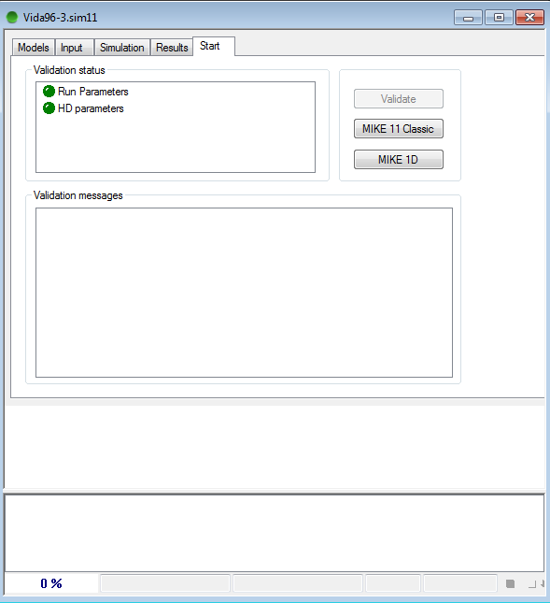
SIMULATION EDITOR
Start Tab
Green Lights Indicate
All Inputs are Valid
A simulation cannot be started until
all lights are green
The Start Tab contains information
on validity of input data
Choice of running MIKE 11 with
2 different engines:
MIKE 11 “Classic”
MIKE 1D (new engine)
“Validation Messages” Display Error
Messages Indicated by the Red Status Light

Slide 11
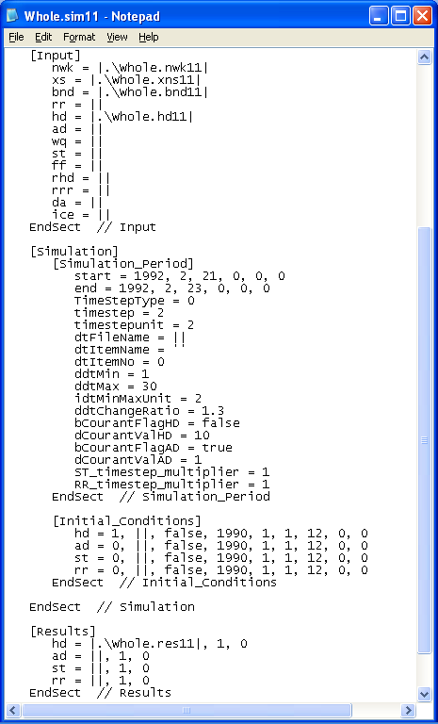
SIMULATION EDITOR
Editable Text File
The Simulation File
can be Edited in any
Text Editor

